Slide 1
Advanced Database Topics Docker
Notes:
Replace this with your course title and your name/contact details.

Slide 2
Containerism
Hypervisor virtualization
One or more independent machines run virtually on physical hardware via an intermediation layer.
Example: VMWare
Containers
Run in user space on top of an operating system’s kernel.
Known as operating system-level virtualization.
Allows multiple isolated user space instances to be run on a single host.
Example: Docker

Slide 3
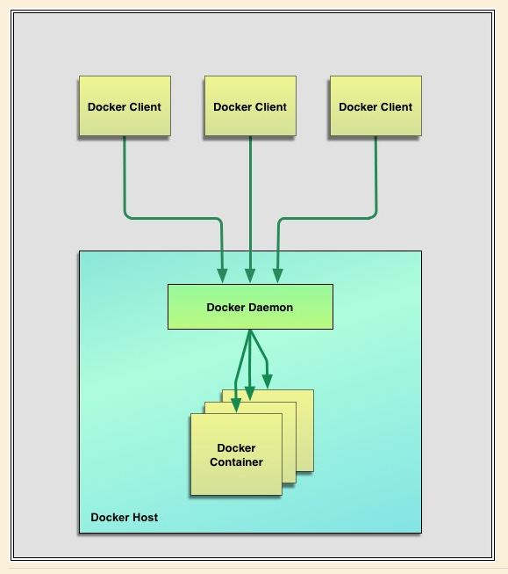
Docker
Docker encourages service-oriented and microservices architectures.
Docker recommends each container run a single application or process, promoting a distributed application model where an app or service is represented by a series of inter-connected containers.
This makes it easy to distribute, scale, debug and introspect your applications.
Docker is a client-server application.
The Docker client talks to the Docker server or daemon, which, in turn, does all the work.
Docker ships with a command line client binary, docker, as well as a full RESTful API to interact with the daemon: dockerd.
Client and server on same or different hosts. .

Slide 4
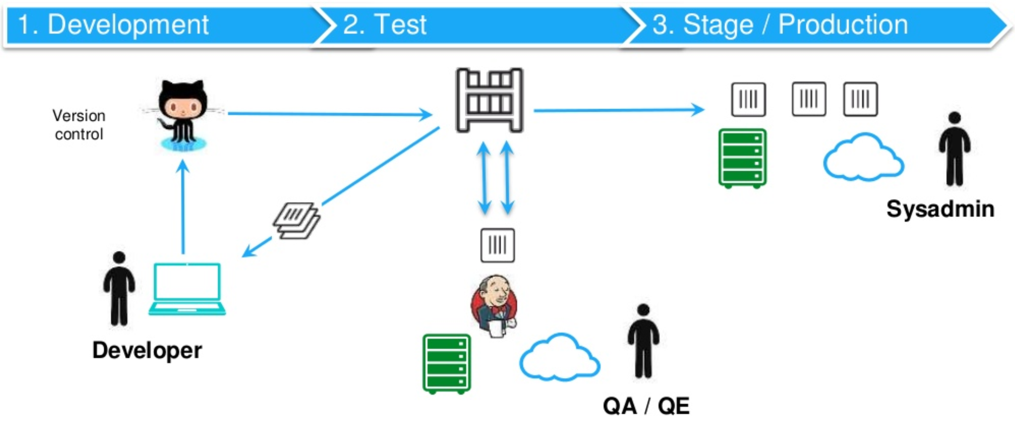
The Value of Containers
In the past, you could have multiple application platforms:
But there could be differences between these environments that would cause implementation reconfiguring.
Docker adds an application deployment engine on top of a virtualized container execution environment. It provides a lightweight, fast environment in which to run your code and an efficient workflow to move code from environment to environment.
A container is a standard unit of software that packages up code and all its dependencies so the application runs quickly and reliably from one computing environment to another. A Docker container image is an, executable package of software that includes everything needed to run an application: code, runtime, system tools, system libraries, settings.

Slide 5
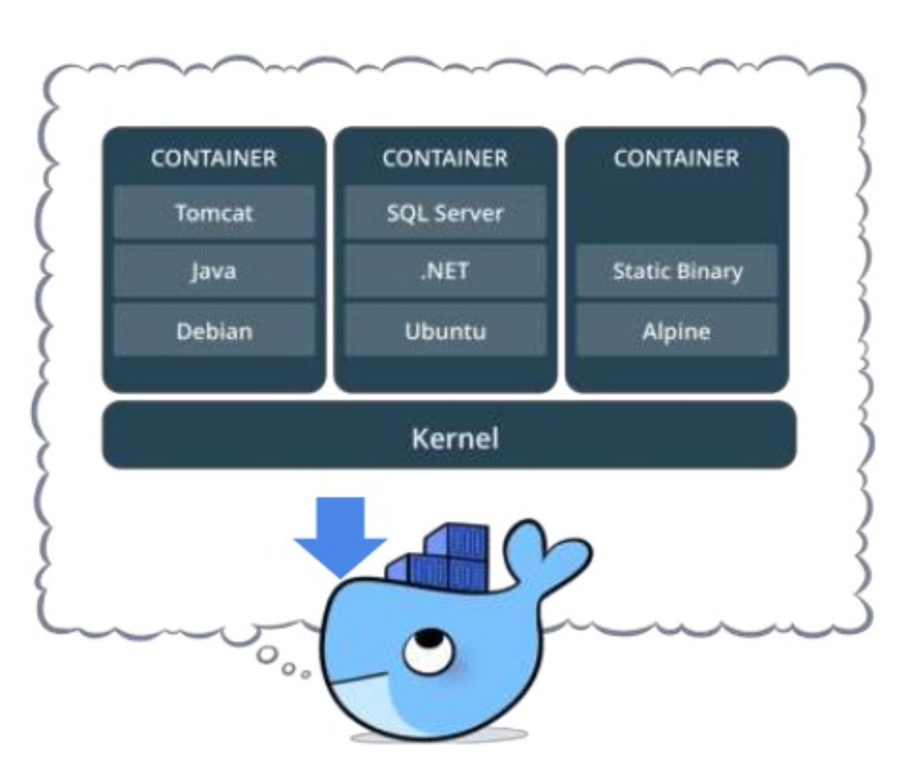
Containers
Containers run instances of the application environments
CONTAINER
CONTAINER
CONTAINER
SQL Server
Elasticsearch
Tomcat
.NET
Logstash
Java
Windows
Kibana
Debian
Ubuntu

Slide 6
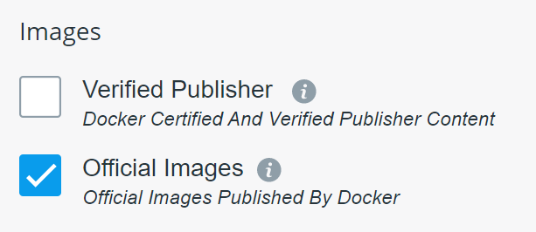
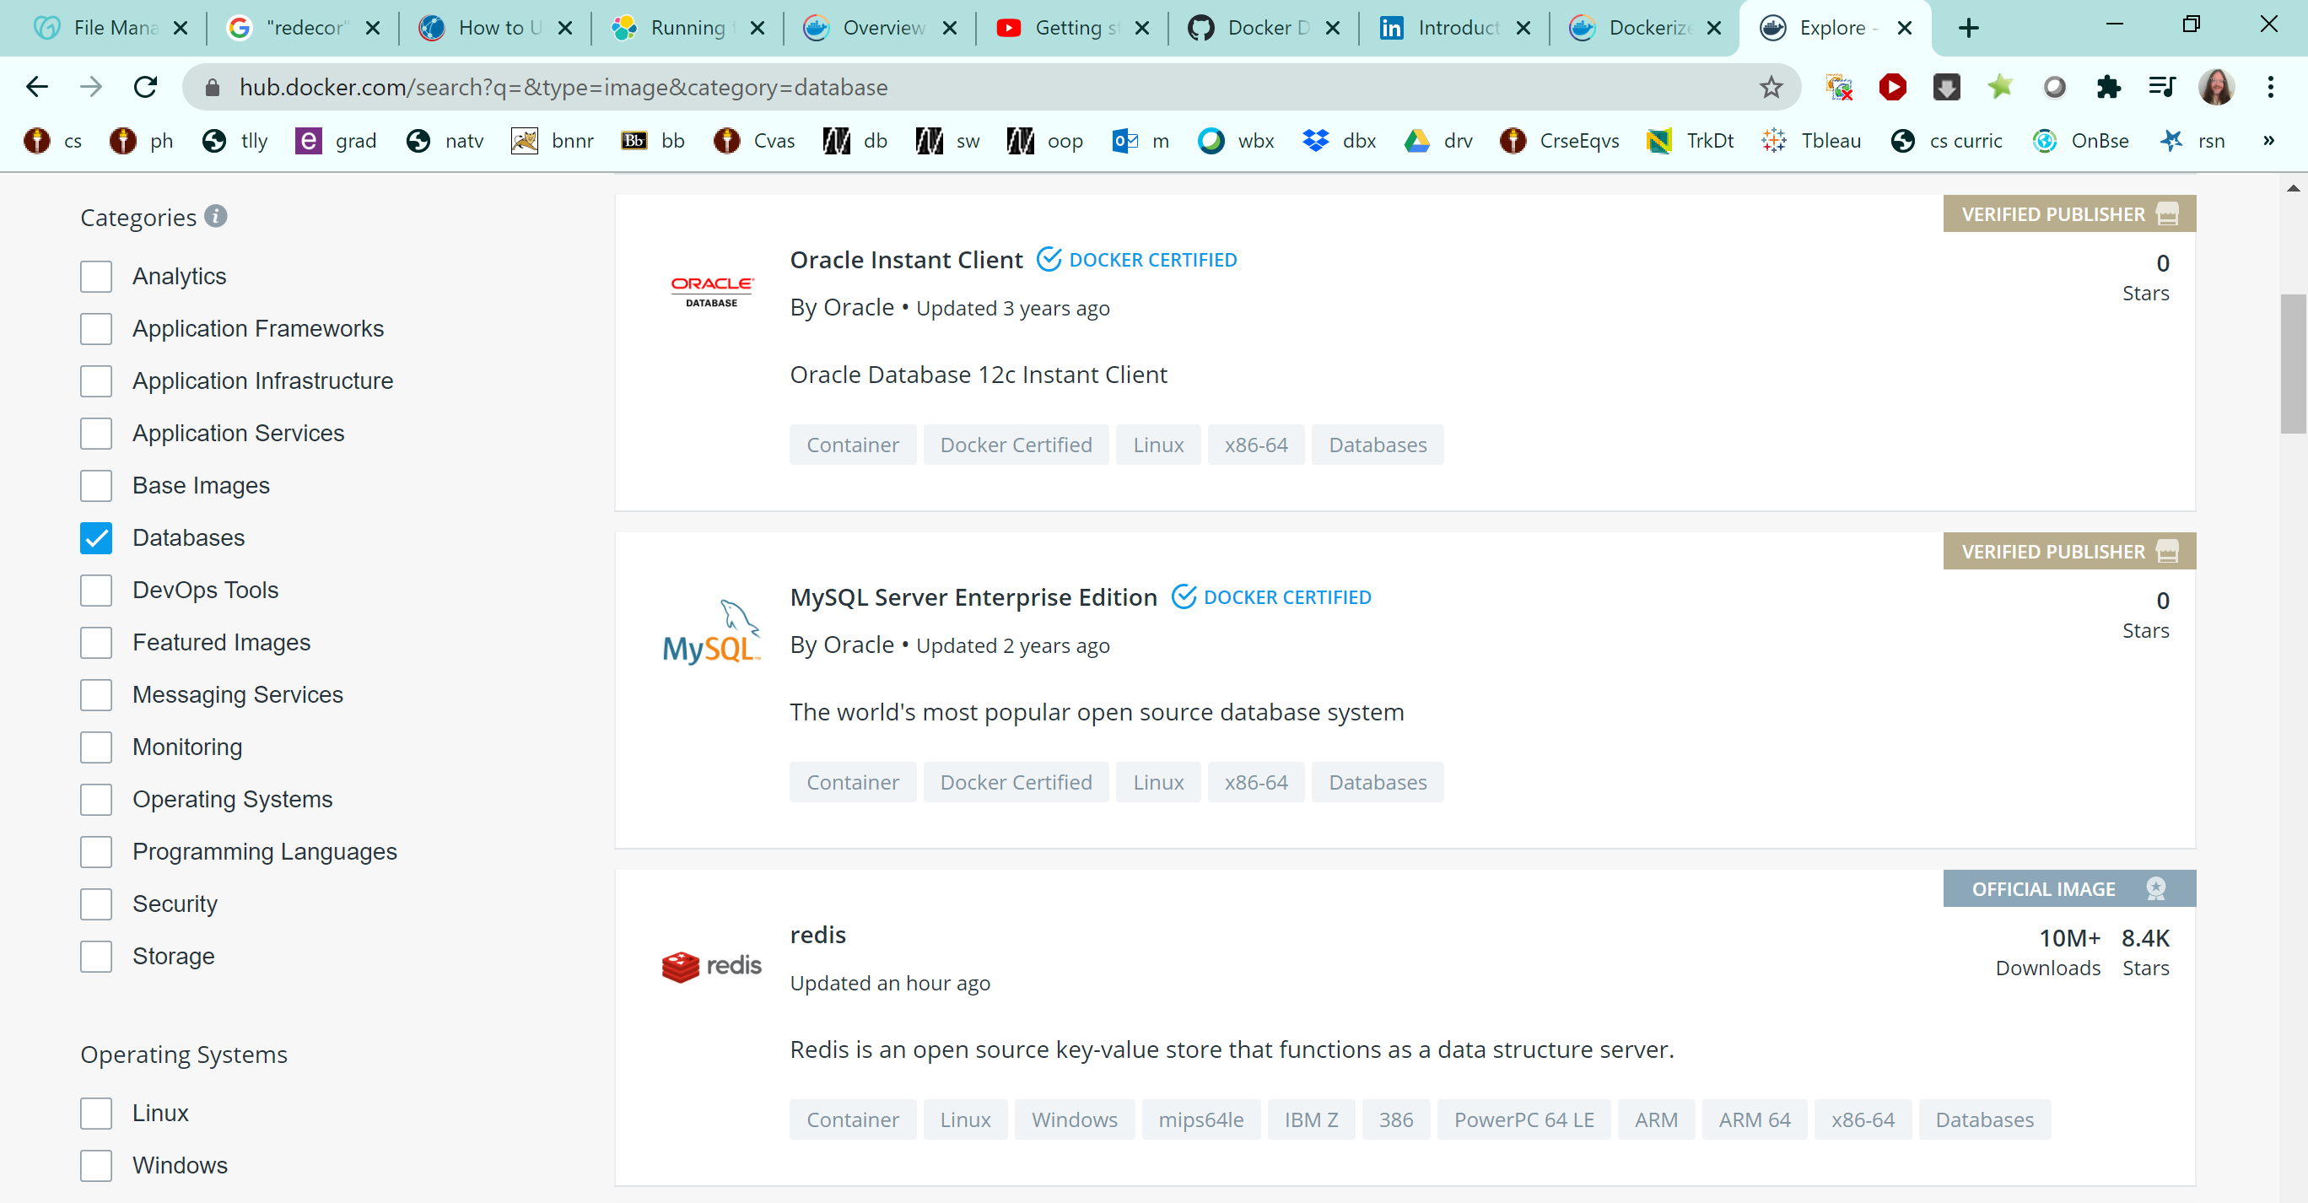

Find containers at hub.docker.com
You can limit searches to official images

Slide 7
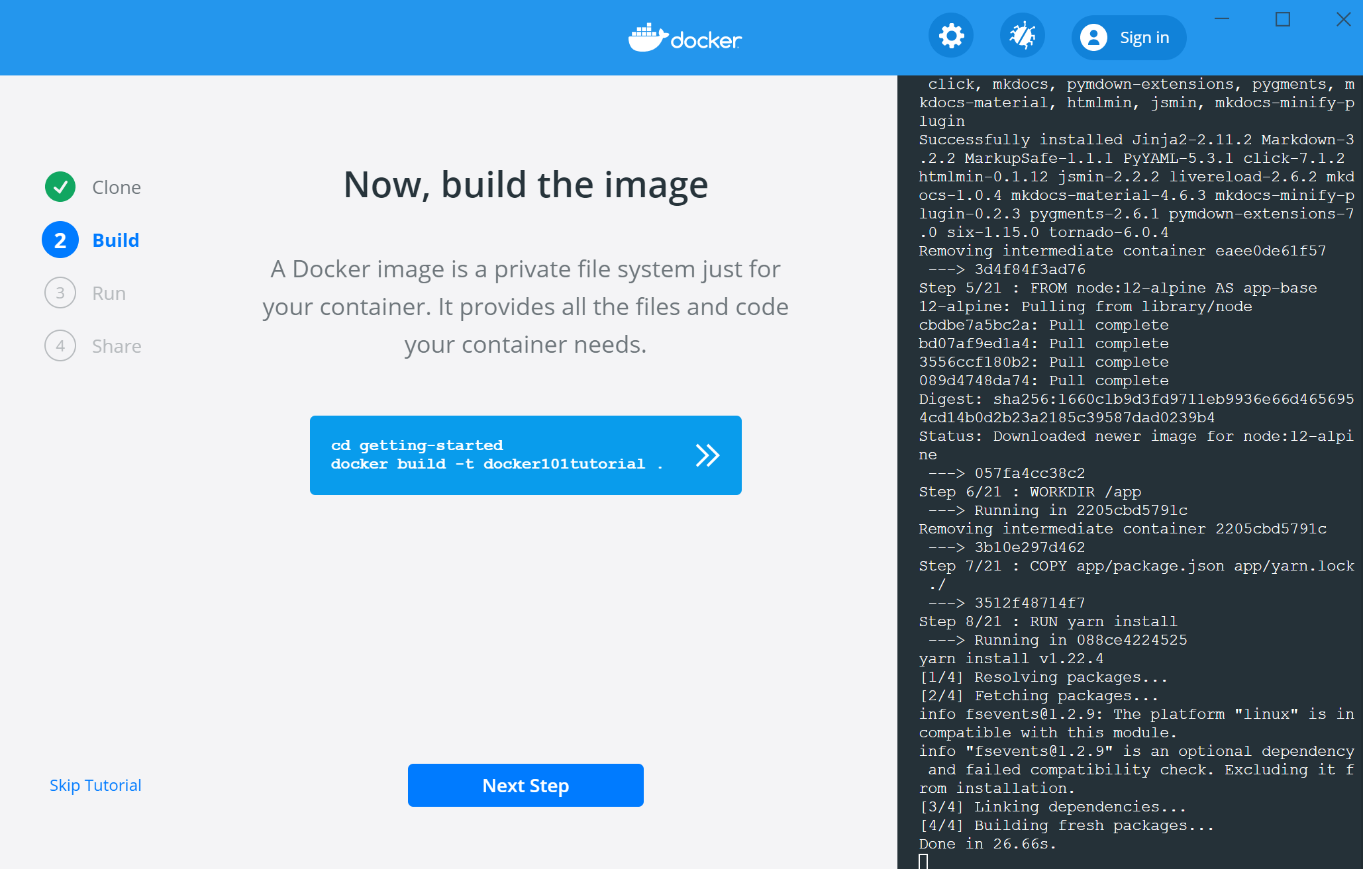
Docker Getting Started Tutorial will Guide you through your first Container

Slide 8
The Powershell Window lets you run docker commands
Docker ps will list containers. Before running the tutorial:
After running the tutorial:
Other commands
Docker ps –a shows containers that have been stopped
Containers can be removed by CONTAINER ID or by NAMES

Slide 9
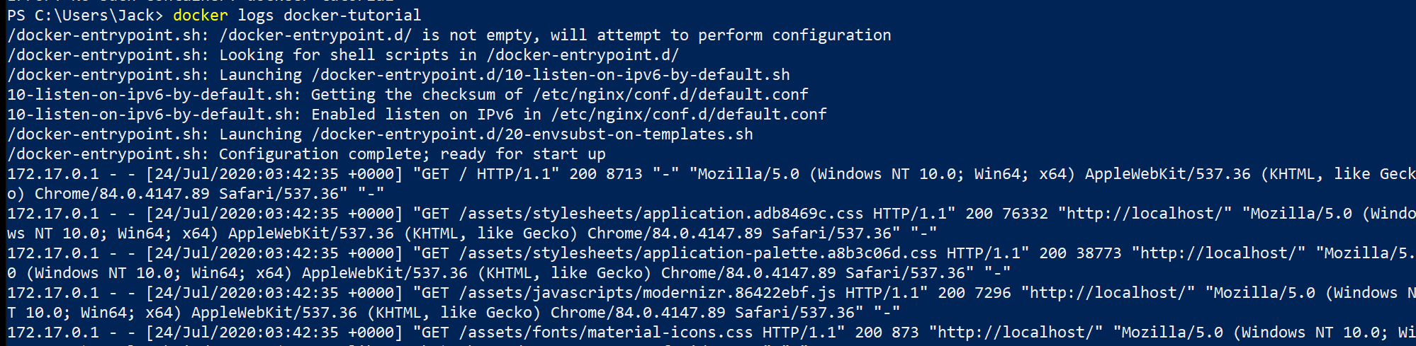
Docker logs

Slide 10
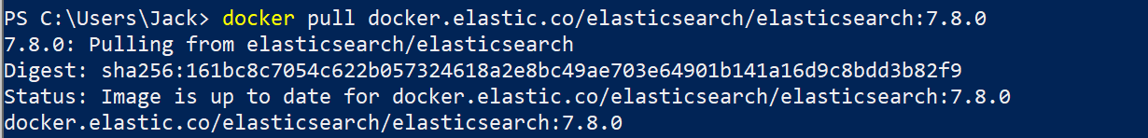
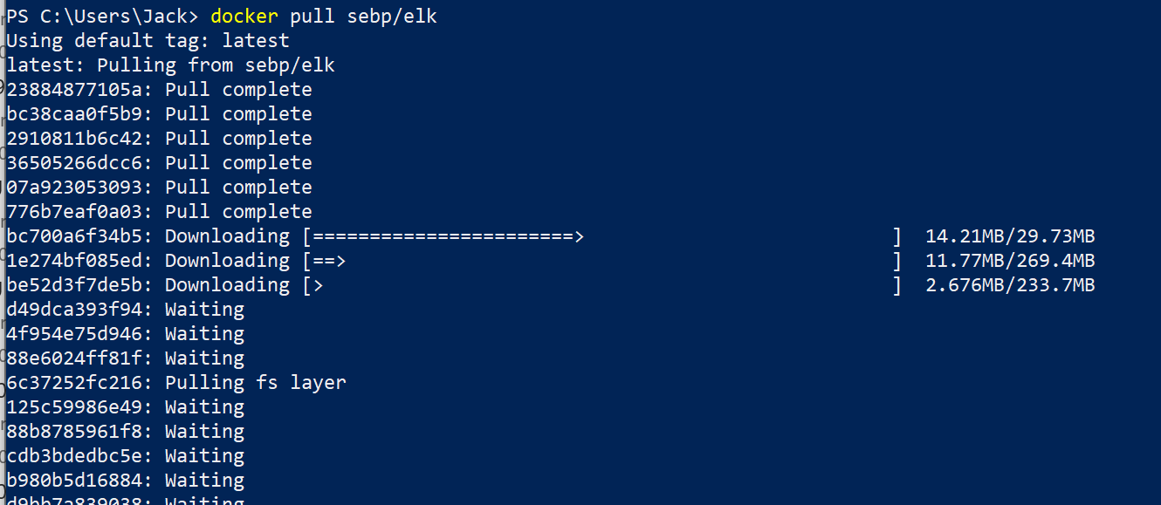
Docker pull (Elasticsearch)
Docker is for environments what GitHub is for code
The docker pull command serves for downloading Docker images from a registry.
If you do a docker pull on an image you will see multiple downloads. Each of those lines are seperate layers.

Slide 11
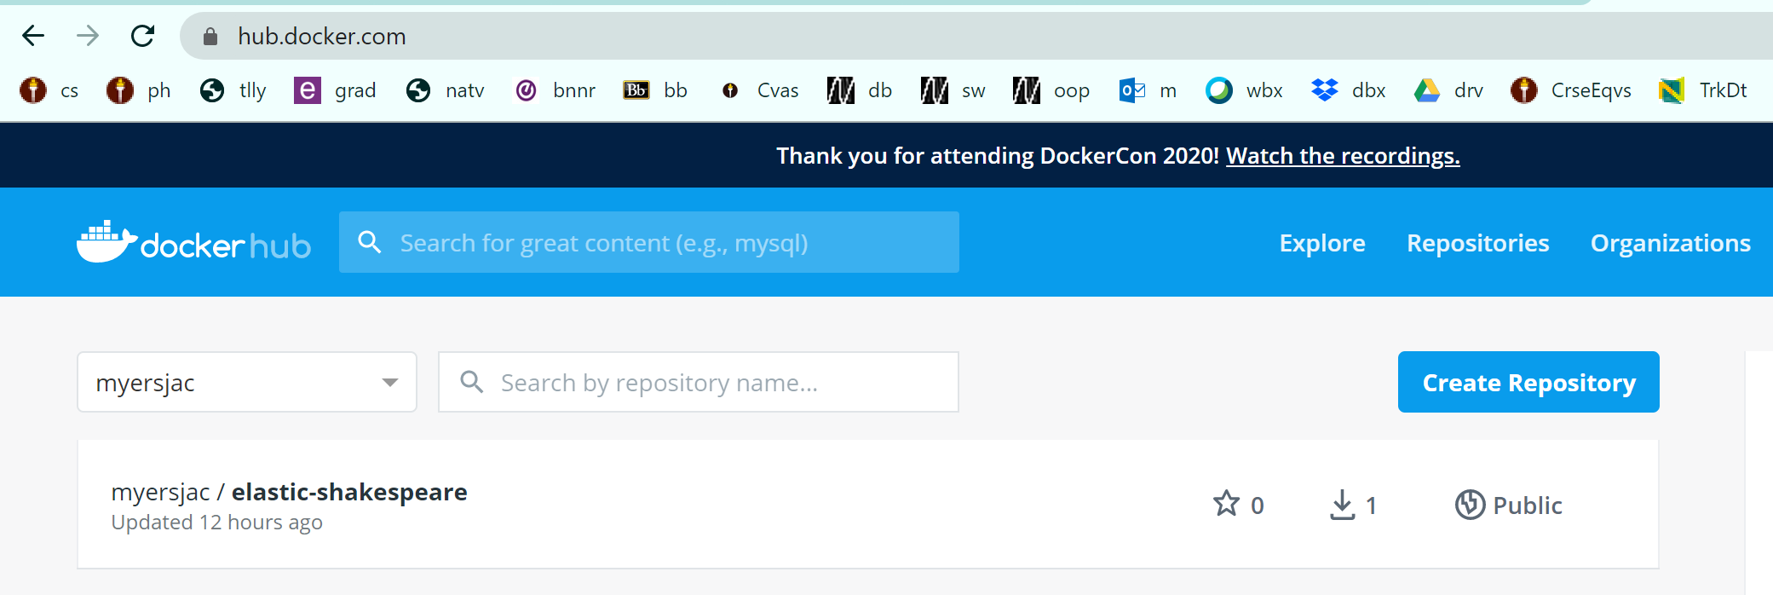
Docker Push
You can play with your container and save its state on your operating system. docker commit 1e840d637ab5 elastic-Shakespeare
Log into dockerhub docker login --username=myersjac
Then you need to tag it docker tag d19a5b6a91fb myersjac/elastic-shakespeare:v1
Then you can push it docker push myersjac/elastic-shakespeare The push refers to repository [docker.io/myersjac/elastic-shakespeare] 54ad594a4be9: Pushed etc... v1: digest: sha256:6871873b99fcfb1f0b2b6fe1d01855c1c9b8bf70d9d0653b453984ddce2bff84 size: 2415

